Slide 1
ELK
Elasticsearch
Logstash
Kibana

Slide 2
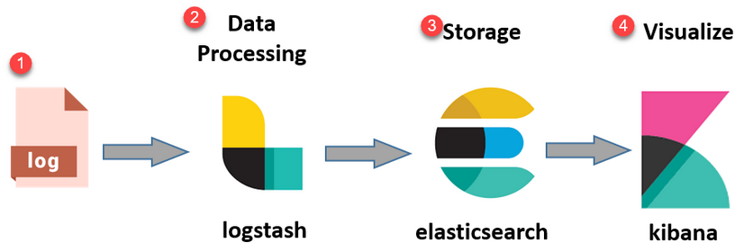
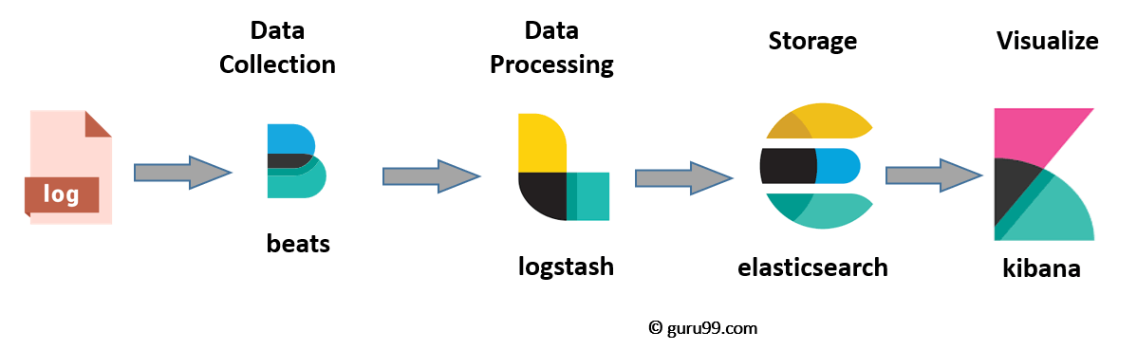
Architecture overview
Installation setup overview
Configuration

Slide 3
Elastiscearch
NoSQL database
  Open source search server is written using Java
  Schema-free, REST & JSON based distributed document store
  Scale vertically and horizontally: sharded, replicated
Lucene search engine
  Full-Text Search
  Near Real Time (NRT) search
RESTful APIS
Can store, search and analyze big volume of data.

Slide 4
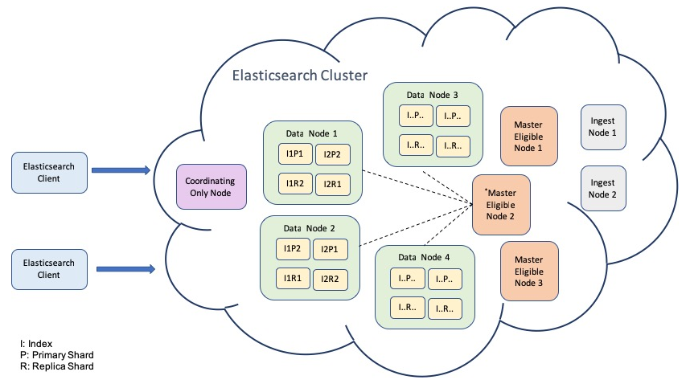
Elasticsearch terms
Cluster - is a collection of nodes which together holds data and provides joined indexing and search capabilities.
Node - is an elasticsearch Instance
Index - is a collection of documents which has similar characteristics
Document - is the basic unit of information which can be indexed. JSON document.
Shard - is the atomic part of an index. The index can be split into several shards to be able to distribute data across nodes.

Slide 5
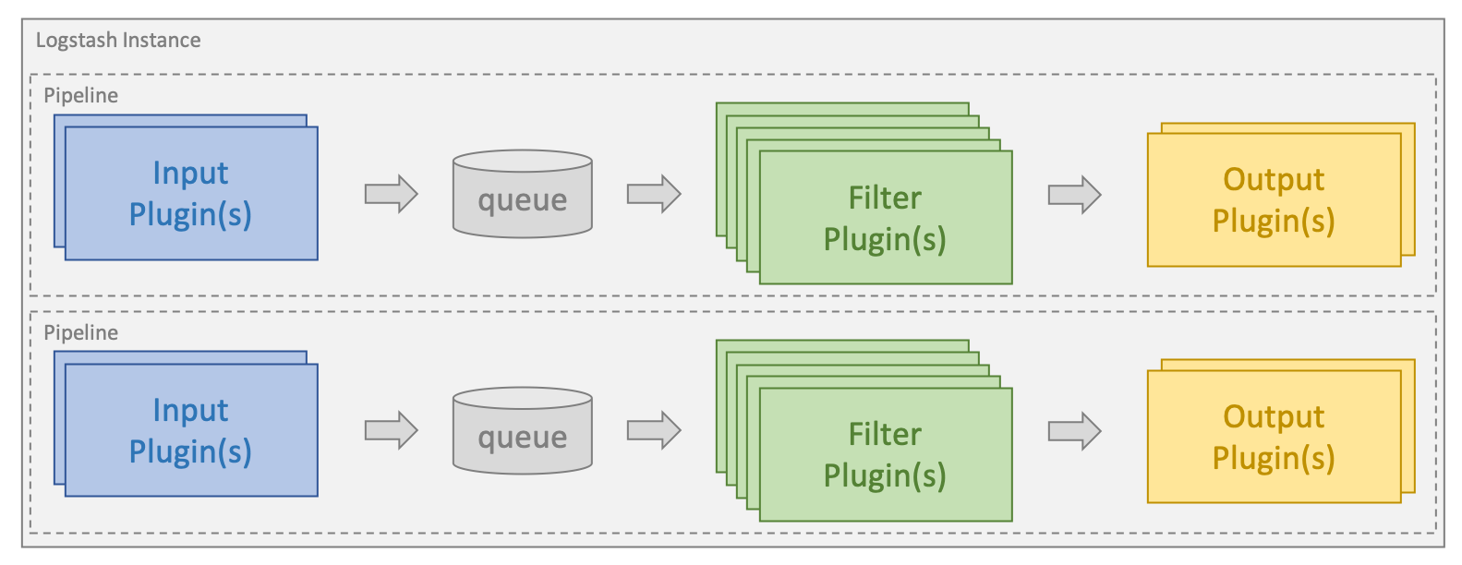
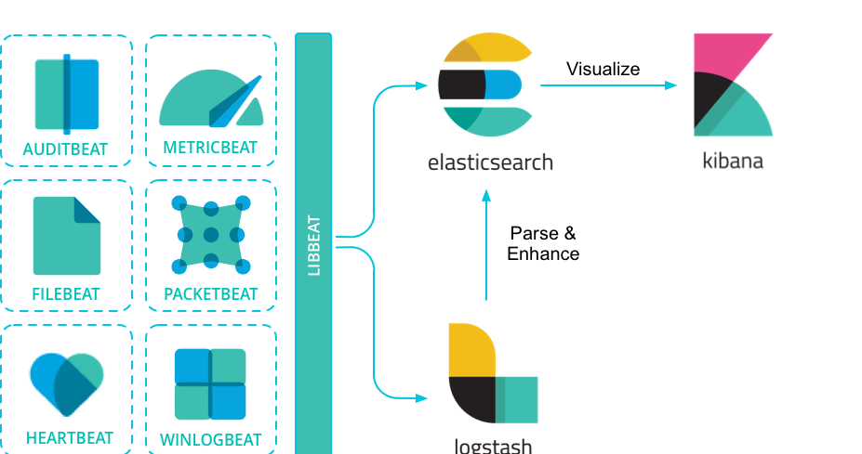
Logstash
Log (event) processor
  Written on ruby, works on java
  Vertical scalability
  Plugins/integrations
  active monitoring API (ES)
Variety log sources (input)
Filters
  transformation
  enrichment
  grok
Variety event destinations (output)

Slide 6
Logstash
Variety log sources:
  Files, tcp/udp based sockets, syslog, snmptrap
  Queues (redis, rabbitmq, kafka, etc)
  http-based hooks
  pool-based events, jdbc, WMI, exec
Also Destinations
Filters
  Data extraction
    grok
  Data filtering
  Data enrichment
  mutate
  aggregate

Slide 7
Logstash configure
/etc/logstash/
  jvm.options
  log4j2.properties
  logstash.yml
  pipelines.yml
  startup.options
  conf.d/
    pipelines*.conf

Slide 8
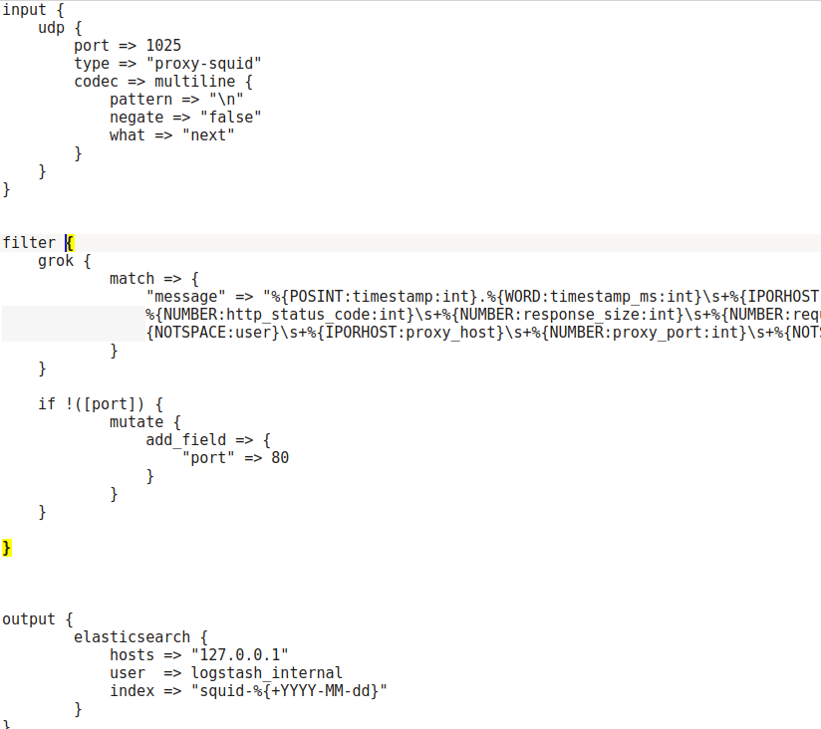
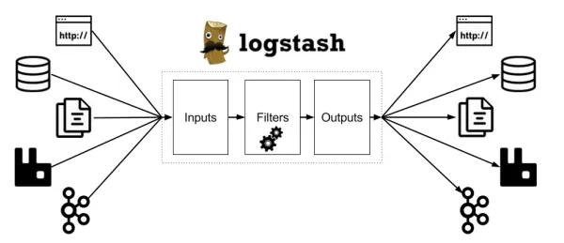
Logstash pipeline

Slide 9
Input plugins
https://www.elastic.co/guide/en/logstash/current/input-plugins.html
listeining service:
  tcp
  udp
  http
  websocket
  socket
  snmptrap
tracking:
  queues
  file
long pooling:
  exec
  http_poller
  jdbc

Slide 10
Filter plugins
age
aggregate
alter
bytes
cidr
cipher
clone
csv
date
de_dot
dissect
dns
drop
elapsed
elastic_integration
elasticsearch
environment
extractnumbers
fingerprint
geoip
grok
http
i18n
java_uuid
jdbc_static
jdbc_streaming
json
json_encode
kv
memcached
metricize
metrics
mutate
prune
range
ruby
sleep
split
syslog_pri
throttle
tld
translate
truncate
urldecode
useragent
uuid
xml
metrics
mutate
prune
range
ruby
sleep
split
syslog_pri
throttle
tld
translate
truncate
urldecode
useragent
uuid
xml
mutate
  coerce
  rename
  update
  replace
  convert
  gsub
  uppercase
  capitalize
  lowercase
  strip
  split
  join
  merge
  copy

Slide 11
Output plugins
boundary
circonus
cloudwatch
csv
datadog
datadog_metrics
dynatrace
elastic_app_search
elastic_workplace_search
elasticsearch
email
exec
file
ganglia
gelf
google_bigquery
google_cloud_storage
google_pubsub
graphite
graphtastic
http
influxdb
irc
java_stdout
juggernaut
kafka
librato
loggly
lumberjack
metriccatcher
mongodb
nagios
nagios_nsca
opentsdb
pagerduty
pipe
rabbitmq
redis
redmine
riak
riemann
s3
sink
sns
solr_http
sqs
statsd
stdout
stomp
syslog
tcp
timber
udp
webhdfs
websocket
xmpp
Zabbix

Slide 12
Logstash grok
2024-02-18T13:20:30.45+03:00 DEBUG This is a sample log
TIMESTAMP LOG LEVEL LOG MESSAGE
%{TIMESTAMP_ISO8601:timestamp} %{LOGLEVEL:log_level} %{GREEDYDATA:log_message}
LOGLEVEL ([Aa]lert|ALERT|[Tt]race|TRACE|[Dd]ebug|DEBUG|[Nn]otice|NOTICE|[Ii]nfo|INFO|[Ww]arn?(?:ing)?|WARN?(?:ING)?|[Ee]rr?(?:or)?|ERR?(?:OR)?|[Cc]rit?(?:ical)?|CRIT?(?:ICAL)?|[Ff]atal|FATAL|[Ss]evere|SEVERE|EMERG(?:ENCY)?|[Ee]merg(?:ency)?)
TIMESTAMP_ISO8601 %{YEAR}-%{MONTHNUM}-%{MONTHDAY}[T ]%{HOUR}:?%{MINUTE}(?::?%{SECOND})?%{ISO8601_TIMEZONE}?
YEAR (?>\d\d){1,2}
MONTHNUM (?:0?[1-9]|1[0-2])
MONTHDAY (?:(?:0[1-9])|(?:[12][0-9])|(?:3[01])|[1-9])
HOUR (?:2[0123]|[01]?[0-9])
MINUTE (?:[0-5][0-9])
SECOND (?:(?:[0-5]?[0-9]|60)(?:[:.,][0-9]+)?)
GREEDYDATA .*
https://github.com/hpcugent/logstash-patterns/blob/master/files/grok-patterns

Slide 13
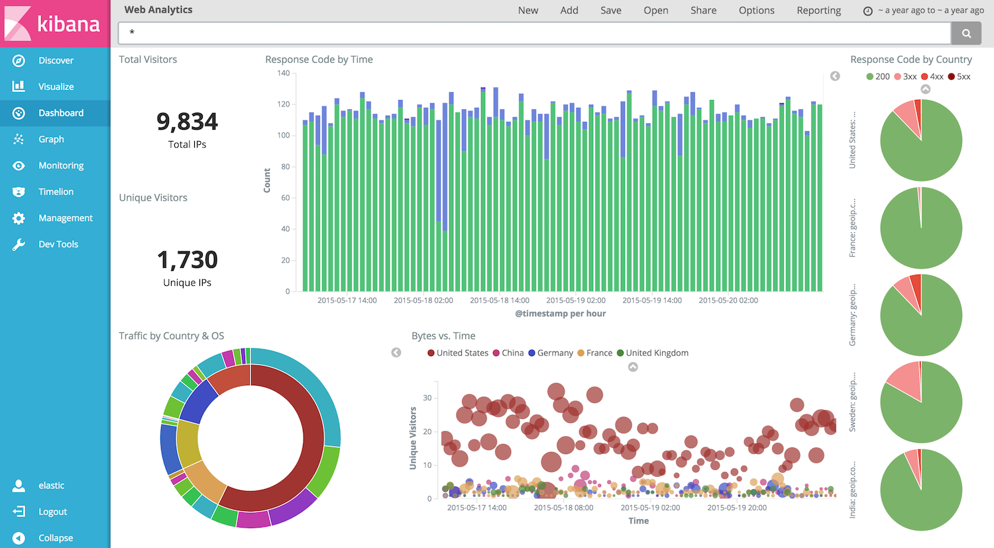
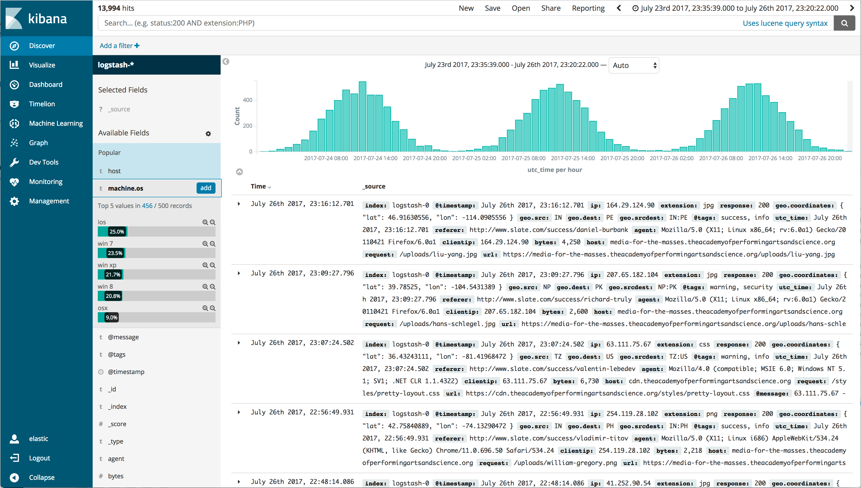
Kibana version 5 and 6

Slide 14
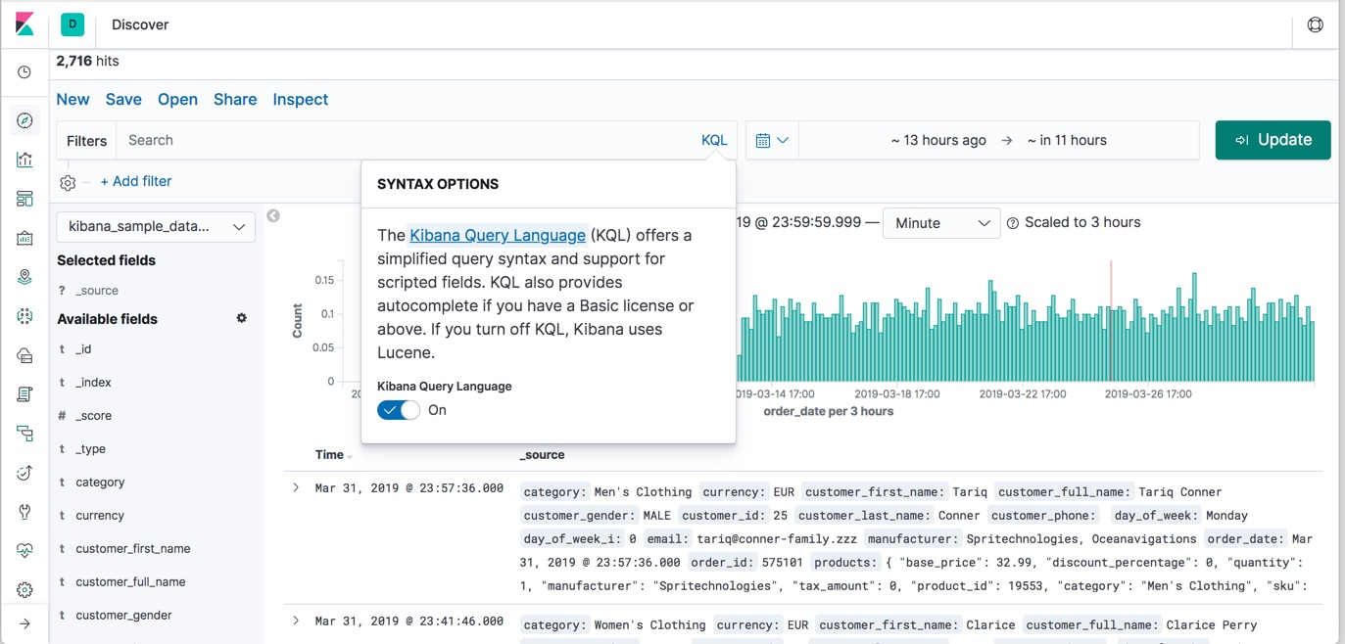
Kibana 7

